Slide 1

Exposures of Fire Fighters during Training Exercises
Dr. Brian E. McCarry, Lorraine Shaw,
Don Shaw and Sujan Fernando
Department of Chemistry and Chemical Biology
McMaster University
Ontario Professional Fire Fighters Association, Health & Safety 2013
Delta Chelsea Hotel, Toronto
February 7, 2013
Notes:
1

Slide 2
Fire Fighter Exposure Study: Research Goals
1. Overall Goal of Study:
To assess exposures of fire fighters to chemicals during fires, both gas-phase and particle phase chemicals.
2. Exposures of Concern:
Gases: carbon monoxide, formaldehyde
Volatile Organic Compounds: benzene, hydrocarbons, etc.
Semi-volatile Compounds: polycyclic aromatic hydrocarbons (PAH).
Particulate Material: particles and chemicals bound to particles
3. How to Assess Exposures?
Air Exposures: active and passive air samplers.
Dermal Exposures: samples from various sites.
Internal Exposures: analysis of smoke-derived chemicals in urine.

Slide 3

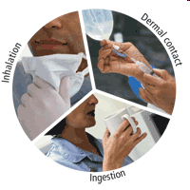
Routes of Chemical Exposures
Inhalation Exposures – Should be low, except when not wearing SCBA (e.g., during knockdown and overhaul).
Ingestion Exposures - Should be minimal for fire fighters.
Dermal (Skin) Exposures – Surprisingly little is known about skin exposures to fire chemicals.

Slide 4
Part 1: Air Sampling,
Skin Sampling and
Analysis of Smoke Samples

Slide 5
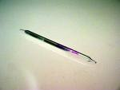
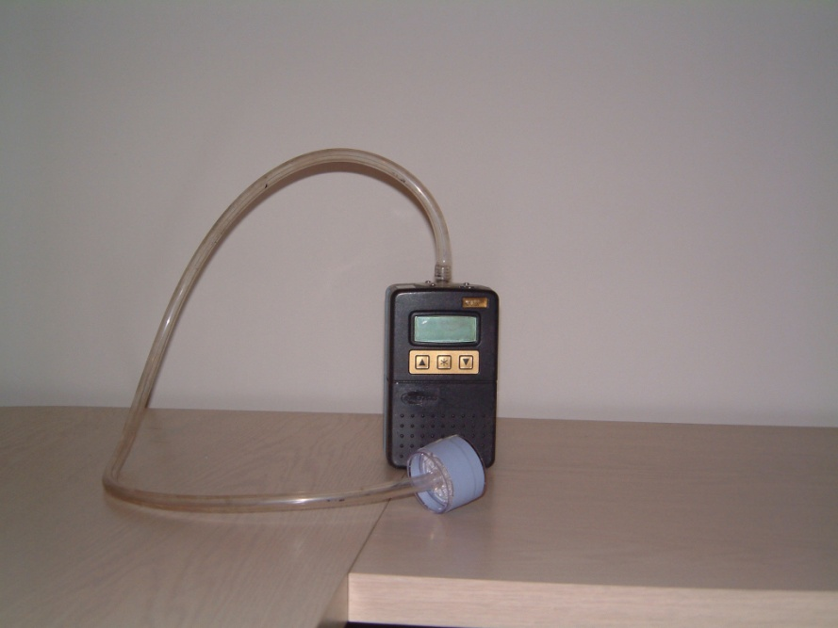
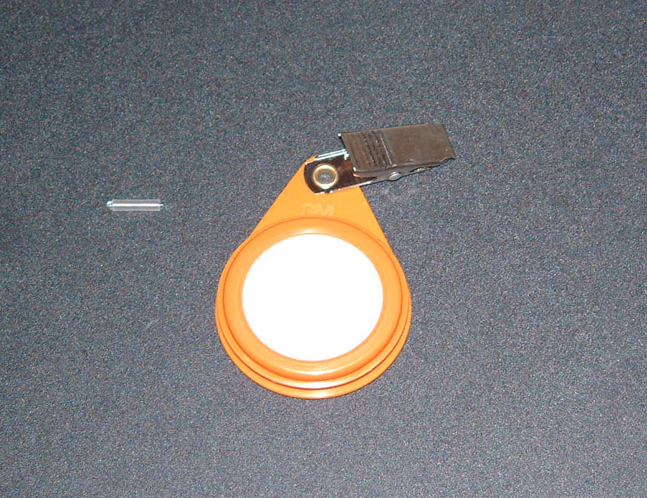
Personal Air Sampling Equipment
Air Sampling:
Active air samplers: Filters and tubes use pumps.
Passive air samplers: Personal Passive Dosimeters (PPDs) and
Twisters® do not use pumps.
Gas sampling tube
Particulate filter attached
to an air pump.
Twister® and 3M Personal Passive Dosimeter (PPD)

Slide 6
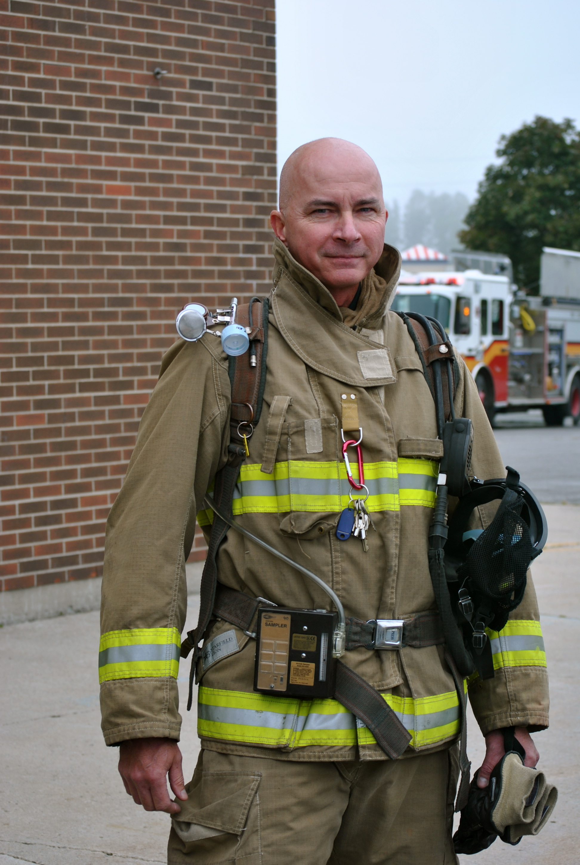
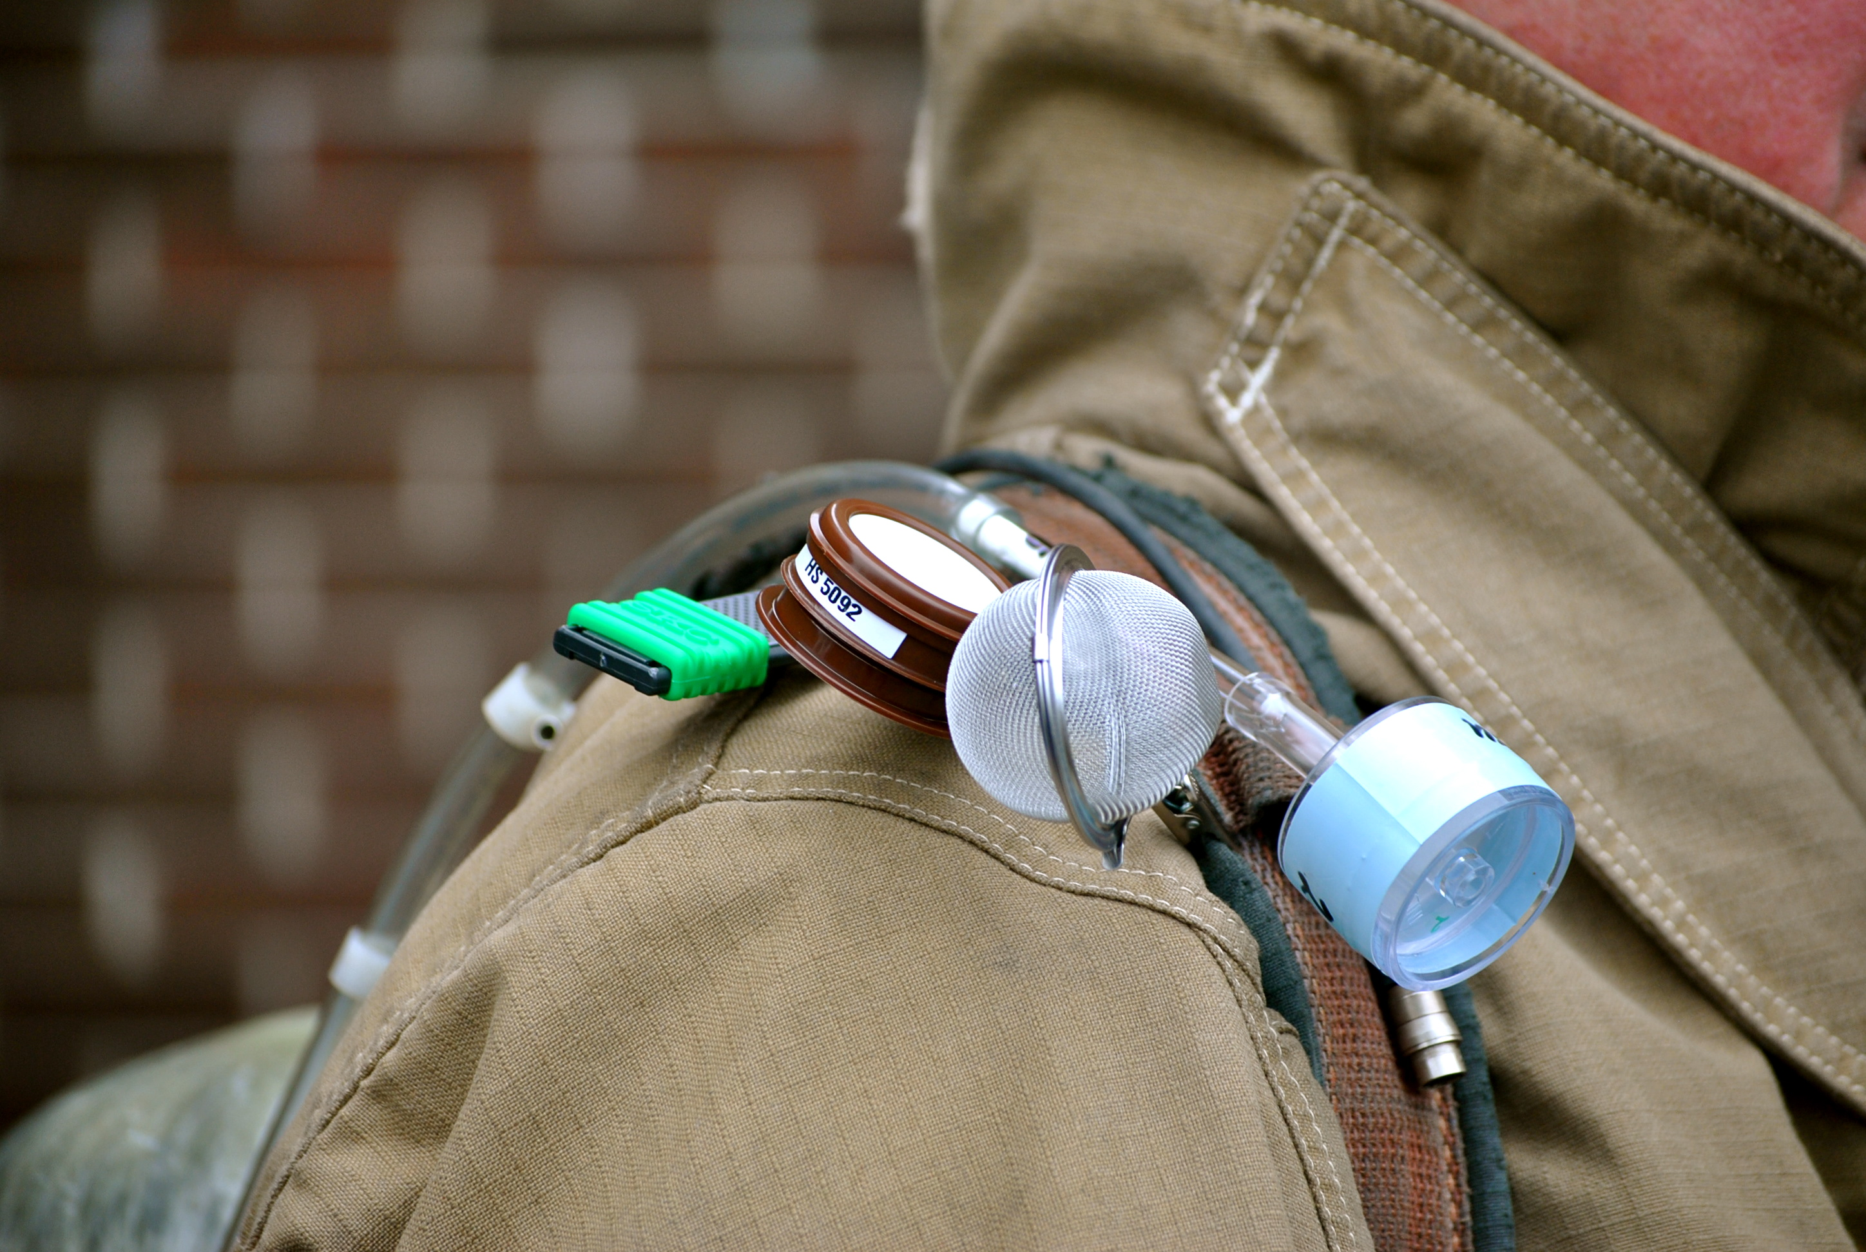
Personal Air Sampling Equipment and
Skin Sampling Sites on Fire Fighters
Active Samplers: Air filter (particulate)
and tube (gases)
forehead
back
neck
wrist
Passive air samplers: PPD and Twister
(inside tea ball)
Air pump for air filter and tube sampler
fingers
Skin sampling sites: back, fingers, forehead, neck, wrist

Slide 7
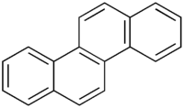
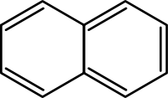

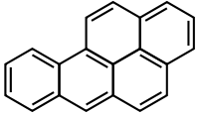

PAH Primer
Polycyclic Aromatic Hydrocarbons (PAH) are by-products of incomplete combustion of carbon-based fuels (wood, plastic, coal, gasoline, diesel fuel, etc.).
Some PAH are carcinogens*, hence concerns about getting cancer from smoke. PAH are metabolized and excreted as hydroxyPAH derivatives in urine and feces.
The levels of hydroxy-PAH in urine are considered to be an excellent measure of human PAH exposures whether via inhalation, ingestion or dermal routes.
Naphthalene**
Anthracene**
Chrysene
** indicates
compound
exists primarily
in gas phase
Benzo[a]pyrene*
Coronene

Slide 8
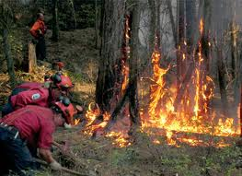
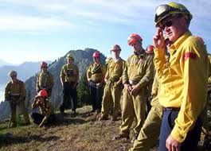
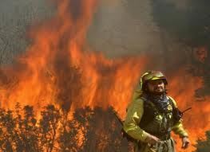
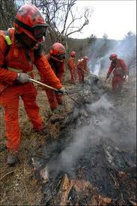
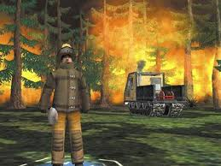
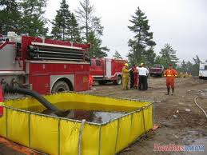
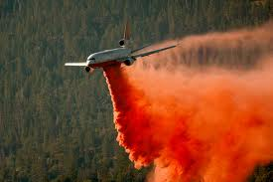
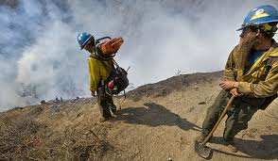
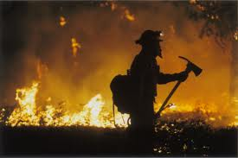
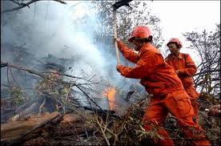
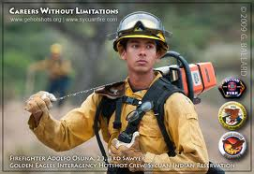
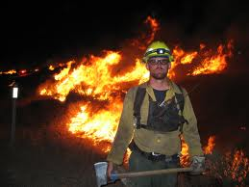
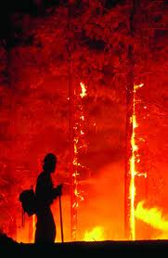
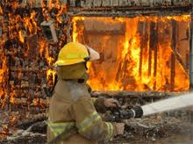
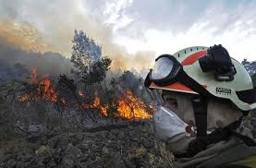
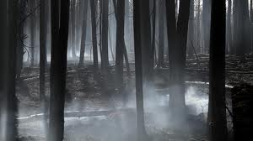
Smoke Exposures of Wildfire Fire Fighters
A number of methoxyphenols were found in wildfire fire fighters’ urines.
Authors proposed these served as useful markers of wood smoke exposures.
We added 20 methoxyphenols to our suite of target chemicals.
Taste of wood smoke Smell of wood smoke
Guaiacols Syringols
Simpson C., “Evaluation of Urinary Methoxyphenols as Biomarkers of Wood
Smoke Exposure.” Environ. Sci. Technol., 2006, 40, 2163-2170.

Slide 9
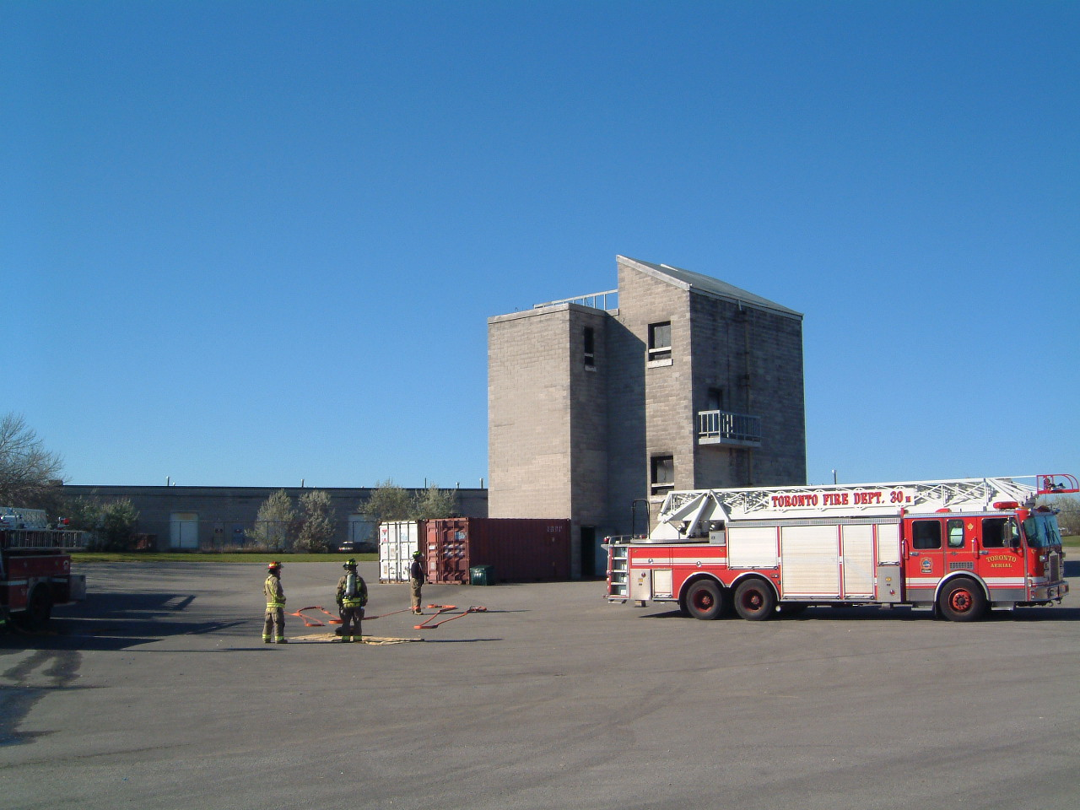
Burn House Training Exercises
Burlington, Hamilton (2x), Ottawa, Toronto Fire Services
Sampling and Analysis:
Air: air particulate, gases (12), VOCs (17),
PAH (25), methoxyphenols (20).
Skin: five sites on each fire fighter.
Urine: before fire exercise and for
the next 24 hours.
Fire Fighter Training Centre, Toronto Fire Department

Slide 10
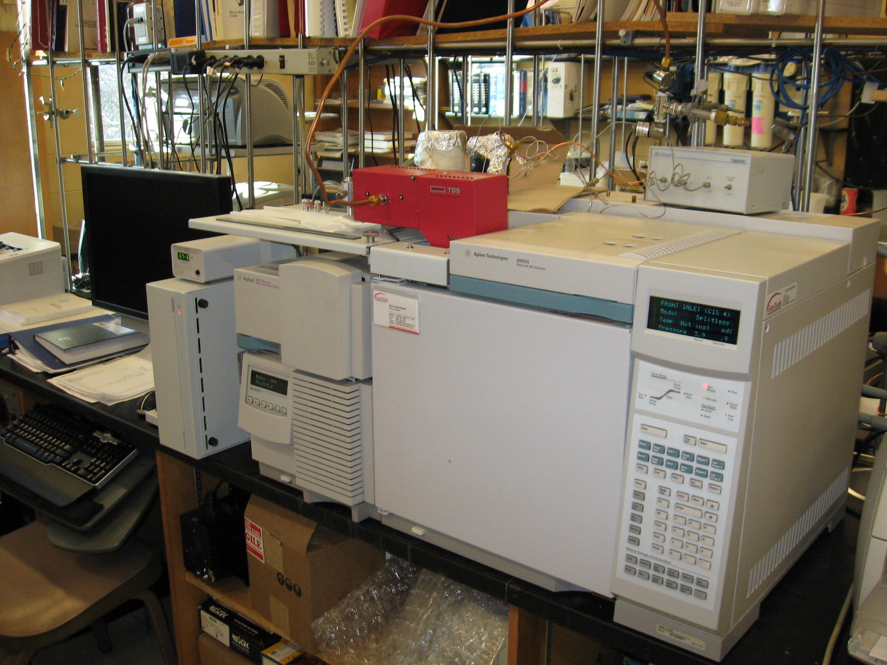
Analytical Instrumentation
Agilent 6890N Gas Chromatograph coupled to an Agilent 5973N MSD Mass Spectrometer

Slide 11
Taste of wood smoke Smell of wood smoke
Analysis of Particle Board Wood Smoke
1. Guaiacol (R=H)
2. Methylguaiacol (R=CH₃)
3. Ethylguaiacol (R=CH₂CH₃)
4. Propylguaiacol (R=CH₂CH₂CH₃)
5. Syringol (R=H)
6. Methylsyringol (R=CH₃)
7. Ethylsyringol (R=CH₂CH₃)
8. Propylsyringol (R=CH₂CH₂CH₃)
6
Gas Chromatography Profile
5
8
7
4
3
2
1
Fluoranthene
Pyrene

Slide 12
Part 2: Assessing Fire Fighter Exposures in Fire Training Exercises:
Particulate and Gases

Slide 13
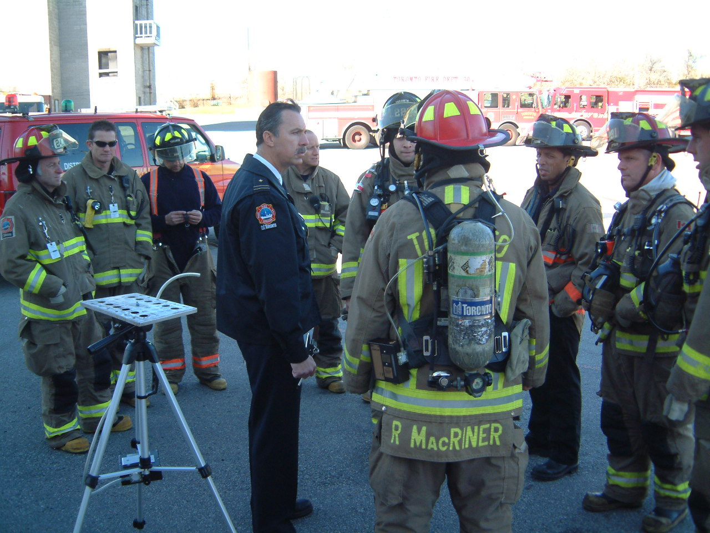
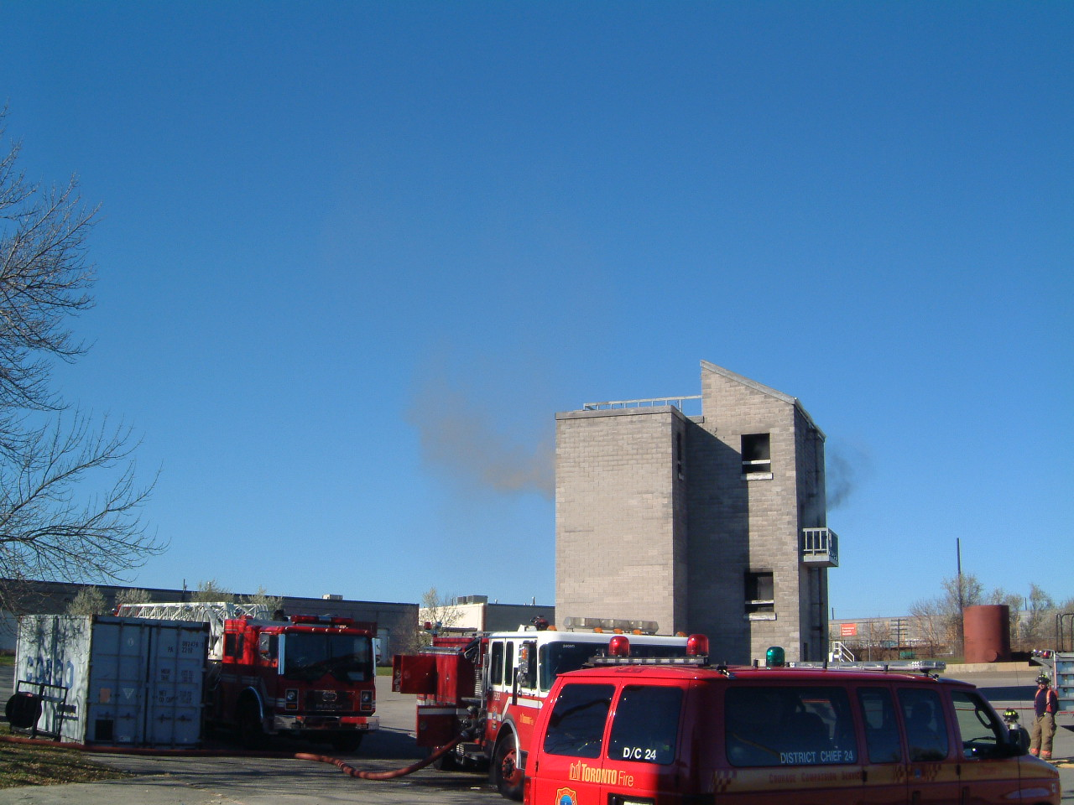
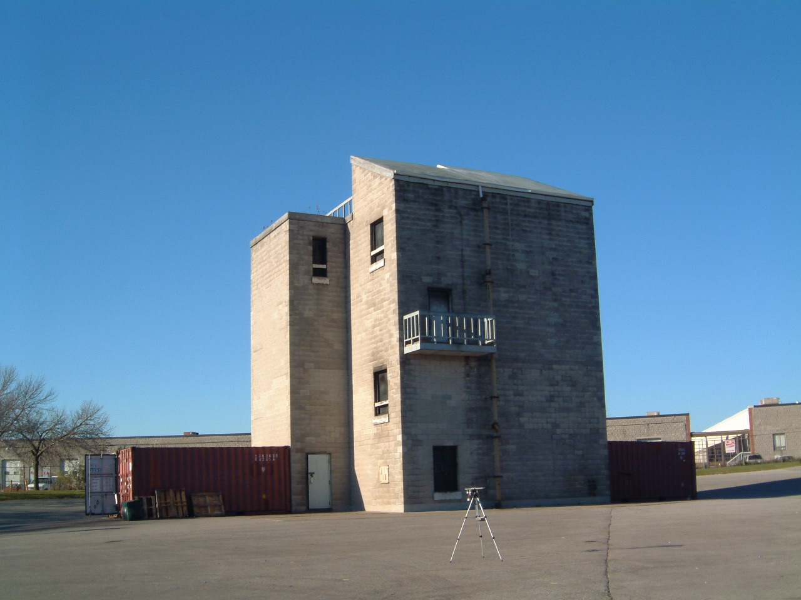
Toronto Fire Service Burn House Training Exercise

Slide 14
Formaldehyde Concentrations in Air
Formaldehyde: ~ 2.5 % of Total VOC Exposure
OEL 0.3 ppm

Slide 15
Comparison: Gas and Particle Phase PAH - Air vs. Skin
28 Fire Fighters
50-80% Gas Phase in Air
Air
Range ~30x
30-80% Gas Phase on Skin
Range ~6x
Skin

Slide 16
Air Sample and Fire Fighter Skin Profiles
PAH
Air Sampler Profiles
Methoxyphenols
Range ~30x
Range ~300x
Skin Profiles
Range ~6x
Range ~9x

Slide 17
Take-home Messages – Part 2
Exposures to particles and gas–phase chemicals in fire training exercises exceed Occupational Exposure Limits.
Skin vs. air exposures:
  Skin exposures correlate roughly with air concentrations.
  Particle-phase chemicals more predominant on skin than in air.
  Even rather low concentrations of chemicals in air can result in significant skin exposures.

Slide 18
Part 3: Skin Sampling:
Evaluation of Body Exposures
to Smoke

Slide 19
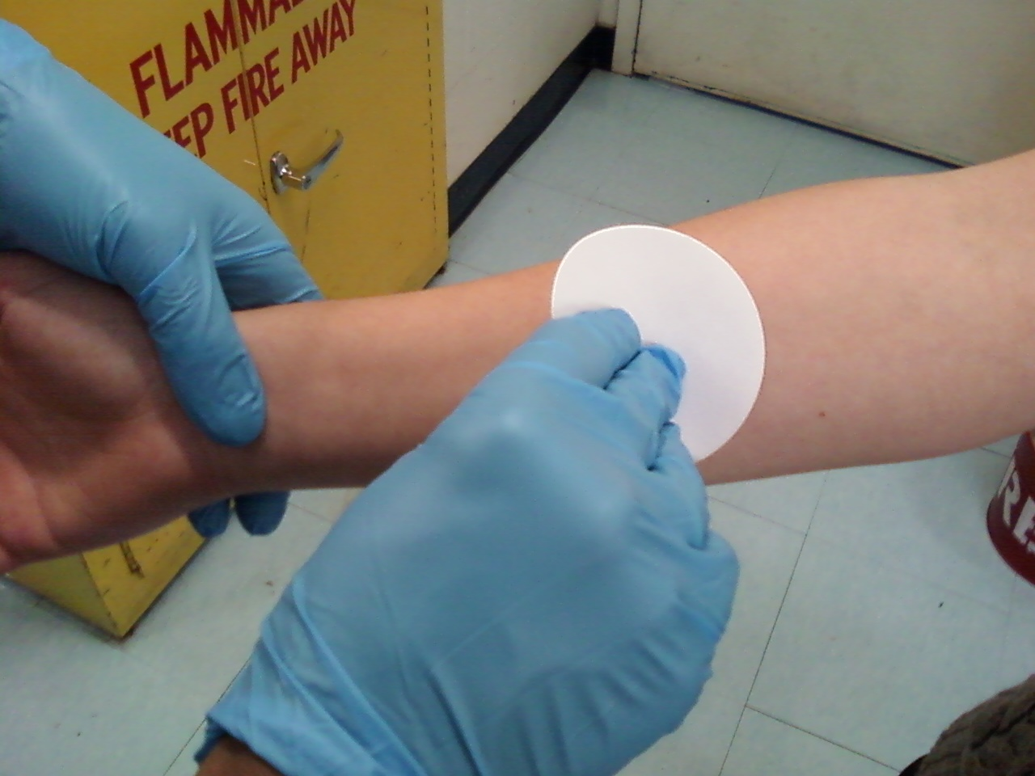
Skin Sampling
Skin Sampling Protocol:
There are no standard methods for sampling chemicals on skin.
We have used a filter paper wipe method with rubbing alcohol (isopropanol).
Fire fighters were sampled before and after exercise in training facility at 5 body sites:
  Back, fingers, forehead, neck and wrist.
Alcohol on Filter Paper Wipe

Slide 20
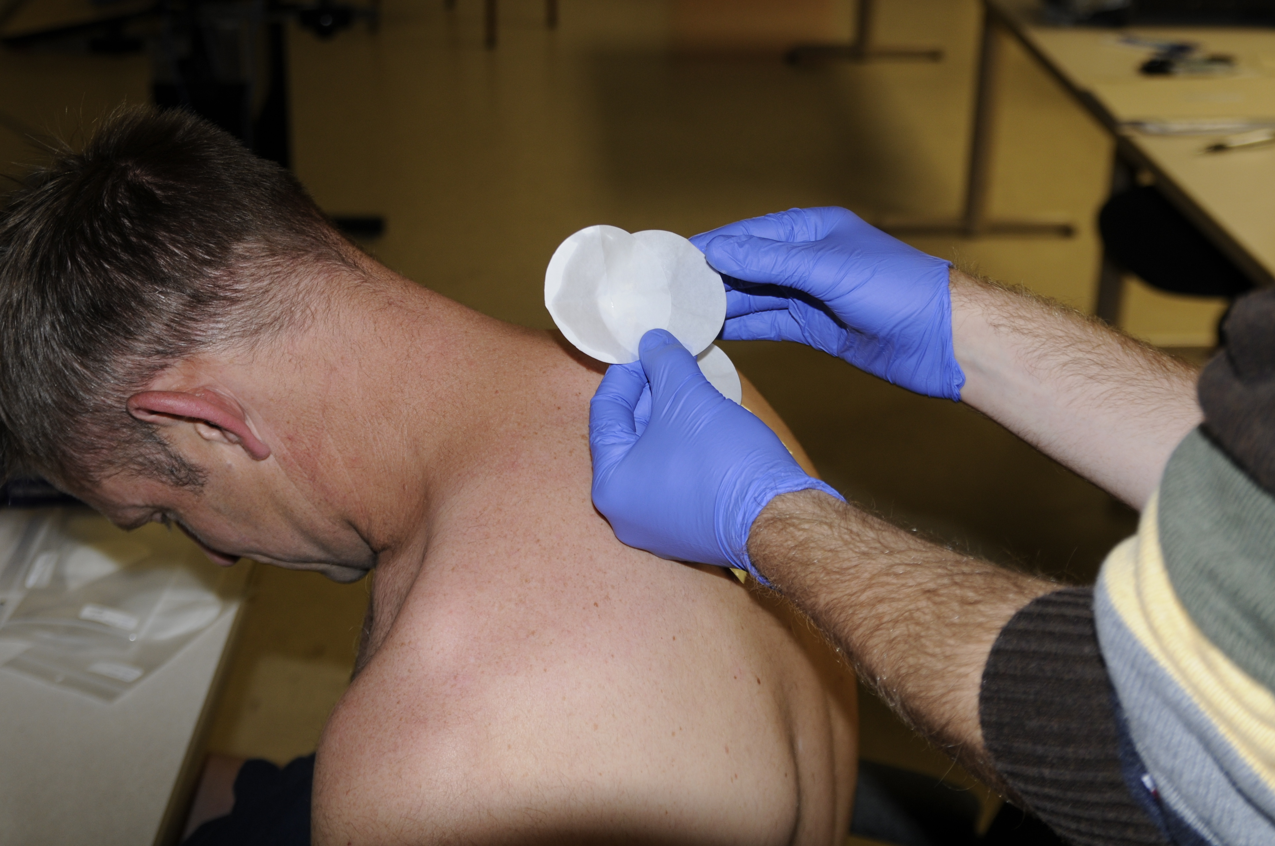
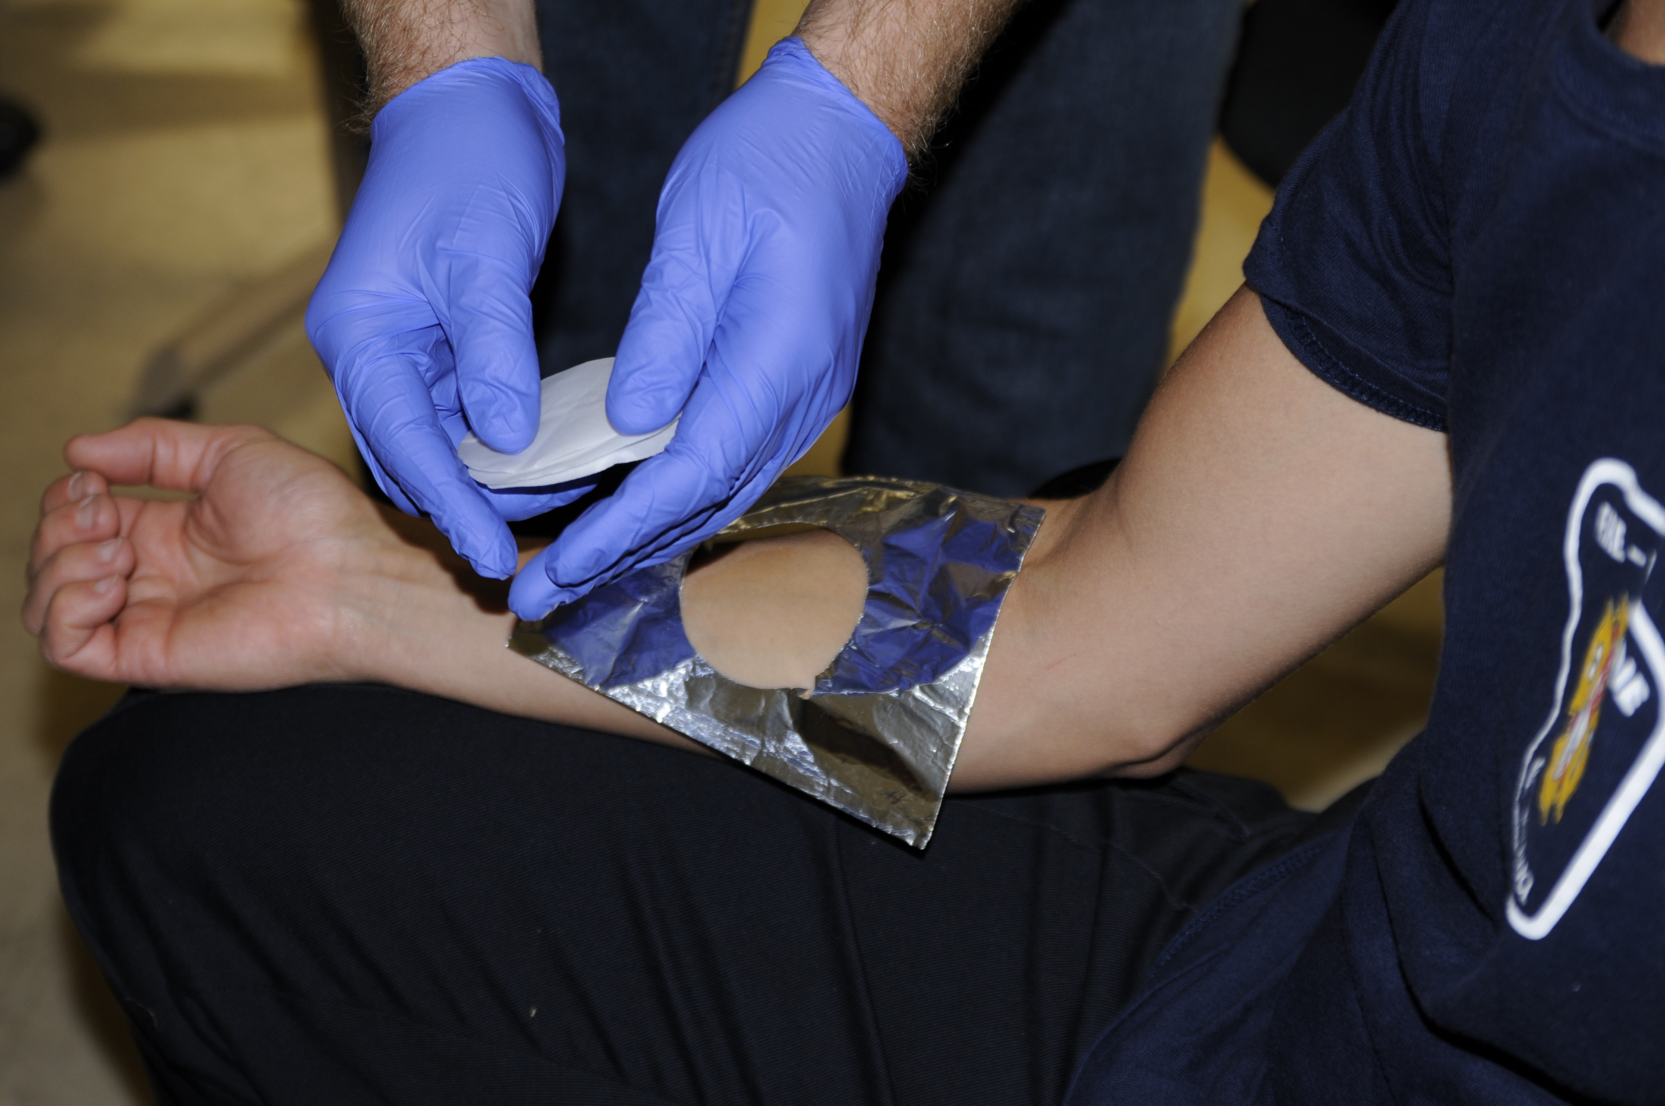
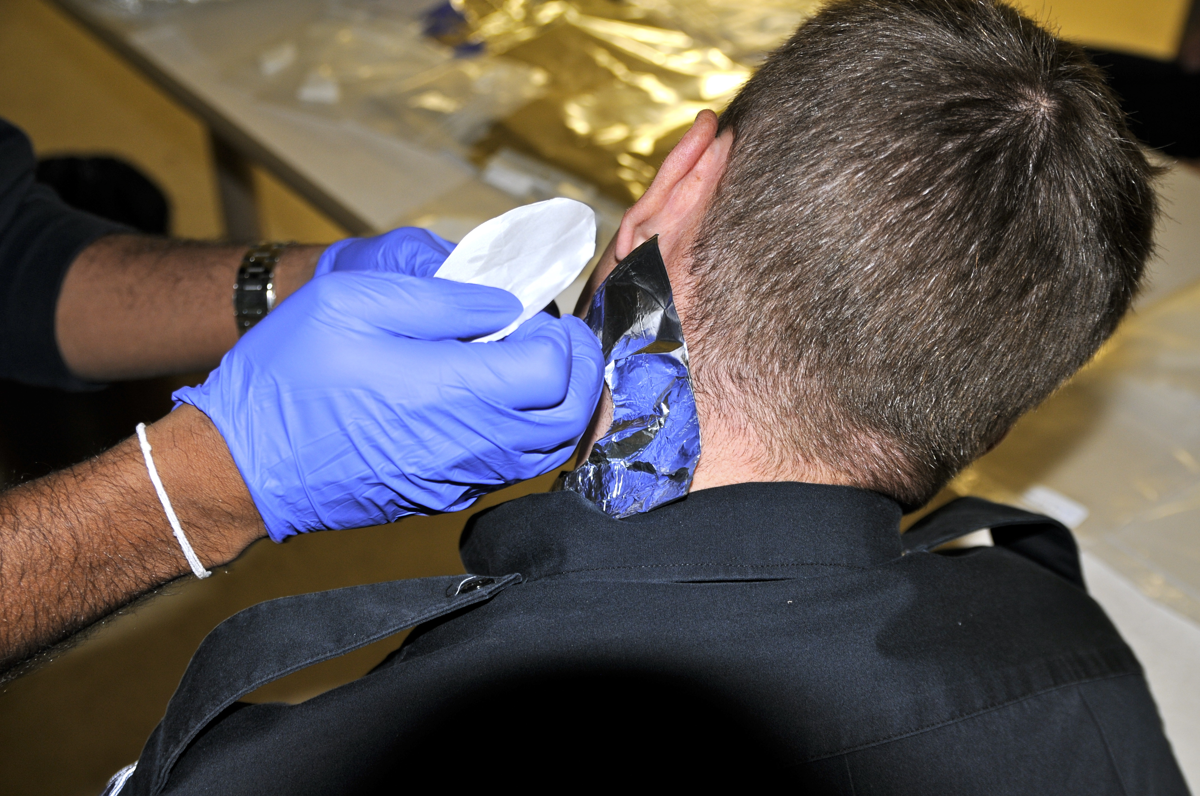
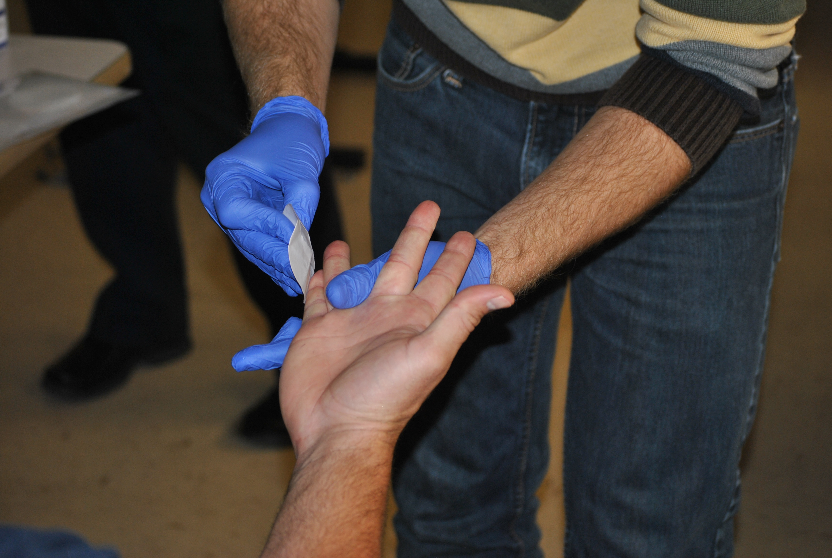
Skin Sampling of Ottawa Fire Fighters
Back
Forearm
Neck
Fingers

Slide 21
PAH and Methoxyphenol Concentrations at 5 Skin Sites
28 Firefighters post smoke exposure 10 Controls

Slide 22
Percentage Compositions of PAH and Methoxyphenols on Skin (28 Fire Fighters)
Conclusion: All skin sites received identical
chemical exposures (except for fingers).
Firefighters get a ‘whole body’ exposure to smoke.
Equal exposures should give 20% at each skin sampling site
T-test (p values)
0.05
0.34
0.18
0.02

Slide 23
Take-home Messages – Part 3
Exposures at 5 sites essentially identical.
Result: a ‘whole body’ exposure.
Finger exposures higher due to post-fire handling of sooty gear.
Recommendations:
  Shower thoroughly at fire hall after a fire.
  Change into clean clothes to go home.
  Don’t wear Nomex undergear home.

Slide 24
Part 4: Urine Sampling:
Analysis of PAH Metabolites and
Methoxyphenols in Urine

Slide 25
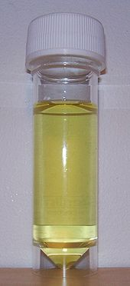
HydroxyPAH and Methoxyphenols as Exposure Indicators
The determination of hydroxyPAH in urine is considered to be the best measure of PAH exposures in humans.
For many years, 1-hydroxypyrene was the only compound used as a PAH exposure marker. Today, a suite of hydroxyPAH is advocated as the new measure of PAH exposure (as used in NHANES Study).
Selected methoxyphenols are good indicators of wood smoke exposures.
Urine Sample

Slide 26
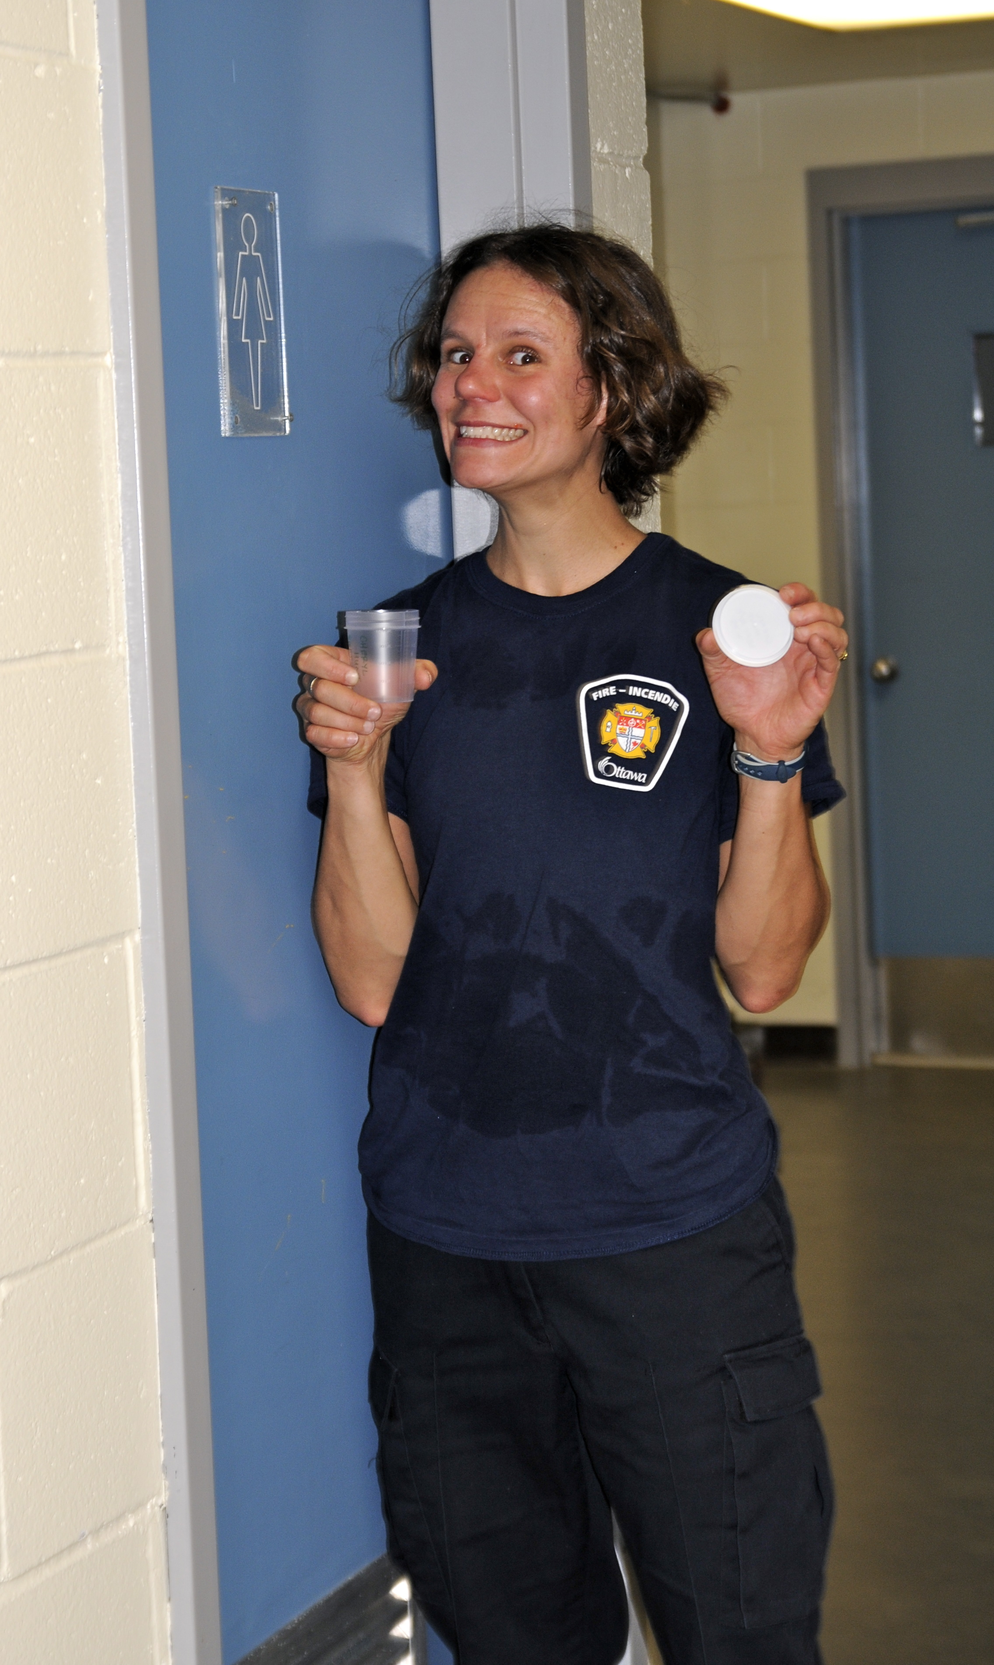
Step 1:
Provide a Urine Sample

Slide 28
HydroxyPAH Urine Profiles of ‘Top 5’ Firefighters

Slide 29
HydroxyPAH Urine Profiles of ‘Low 5’ Firefighters

Slide 30
Methylsyringol and Hydroxyfluorene Levels in FF Urines
Methylsyringol
Surprisingly wide
range of exposures
among trainees
in same groups.
Sum of Three Hydroxyfluorenes
Even controls have
a background of
hydroxyfluorenes
28 Firefighters 10 Controls

Slide 31
Net Methylsyringol Levels in All Fire Fighters
Sorted by methylsyringol levels: ‘Top 5’ and ‘Low 5’ highlighted
Low 5
Top 5
Notes:
31

Slide 32

Urinary Methylsyringol Profiles of ‘Top 5’ Fire Fighters over 24 Hours
Post Exposure¹
(6000 ± 4000)
Pre Exposure¹
(700 ± 700)
Methylsyringol shown to be the “best” marker of wood smoke exposures. Methylsyringol levels very low before exposure and return to low levels within 24 hours. Simpson C., “Evaluation of Urinary Methoxyphenols as Biomarkers of Wood Smoke Exposure.” Environ. Sci. Technol., 2006, 40, 2163-2170.

Slide 33
Urinary Methylsyringol Profiles of ‘Low 5’ Fire Fighters over 24 Hours
Pre Exposure Values
(700 ± 700)
Note: Scale on this graph is 140 times less than previous “Top 5 Fire Fighters” plot.

Slide 34
Take-home Messages – Part 4
Reliable urinary markers of wood smoke exposures (hydroxyPAH and methoxyphenols) confirmed.
Exposures to smoke chemicals varied greatly.
In highest exposures, hydroxyPAH levels equaled levels found in average US smoker.
After 24 hours hydroxyPAH and methoxyphenols in urine returned to pre-exposure levels.
Recommendations:
  Make sure SCBAs are properly fitted on fire fighters.
  Drink lots of fluids after fire.

Slide 35
Part 5: Identification of New Markers of Smoke Exposures
Analysis of Smoke and Urine Samples to Identify New Chemical Indicators of Smoke Exposures

Slide 36
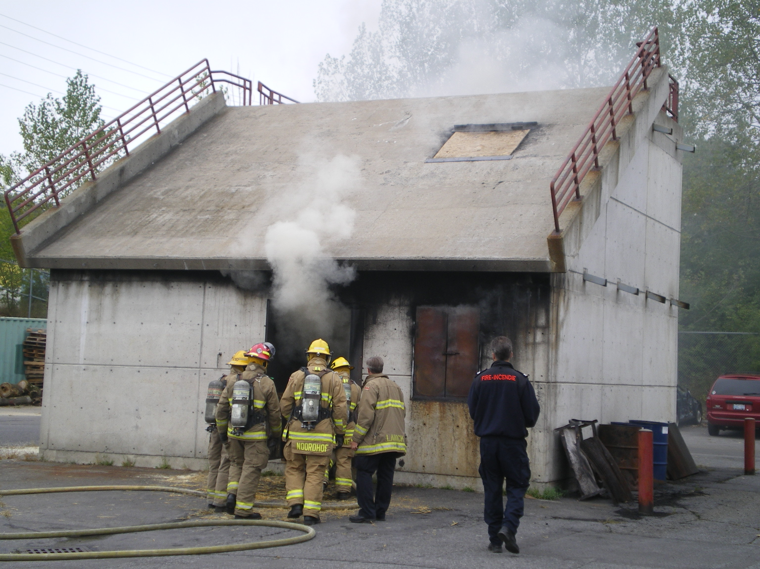
Firefighter Trainees Entering
Facility for 30-minute
Fire Training Session

Slide 37
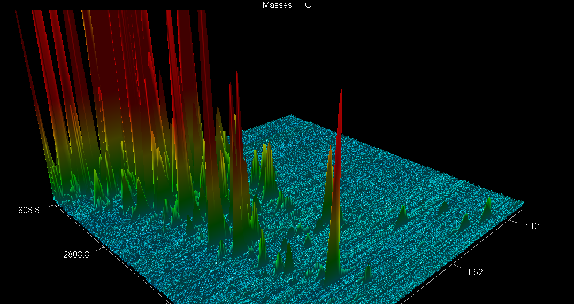

GC×GC Analysis of Firefighter Smoke
How many of the 1500 compounds in smoke
can be found in post-exposure urine?
Gas-phase chemicals
Gas + Particle-phase chemicals
Particle-phase chemicals
The presence of particle-associated chemicals in urine
would be useful indicators of particle exposures.
1st Dimension Time (s)
2nd Dimension Time (s)

Slide 38
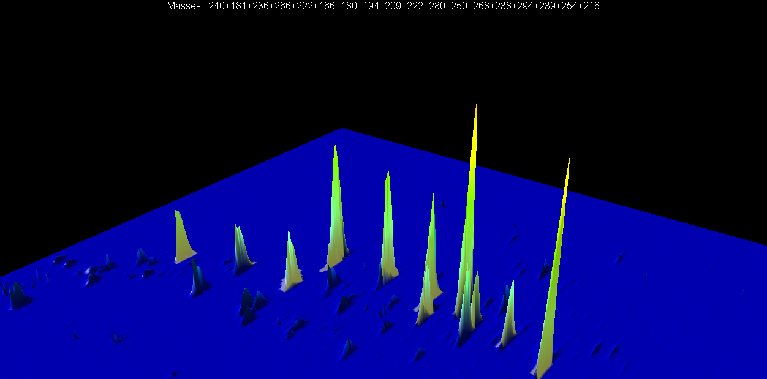
Two-dimensional GC Analysis of Wood Smoke:
Identification of Four New Methoxyphenol Wood Smoke Markers
C₄-Guaiacol (new)
Twister Extract
C₂-Syringol
C₃-Syringol
C₁-Syringol
C₅-Guaiacols (new)
Syringol
Guaiacol
C₁-Guaiacol
C₂-Guaiacol
Different ratios of
guaiacols and
syringols in different
smoke samples.
C₃-Guaiacol

Slide 39
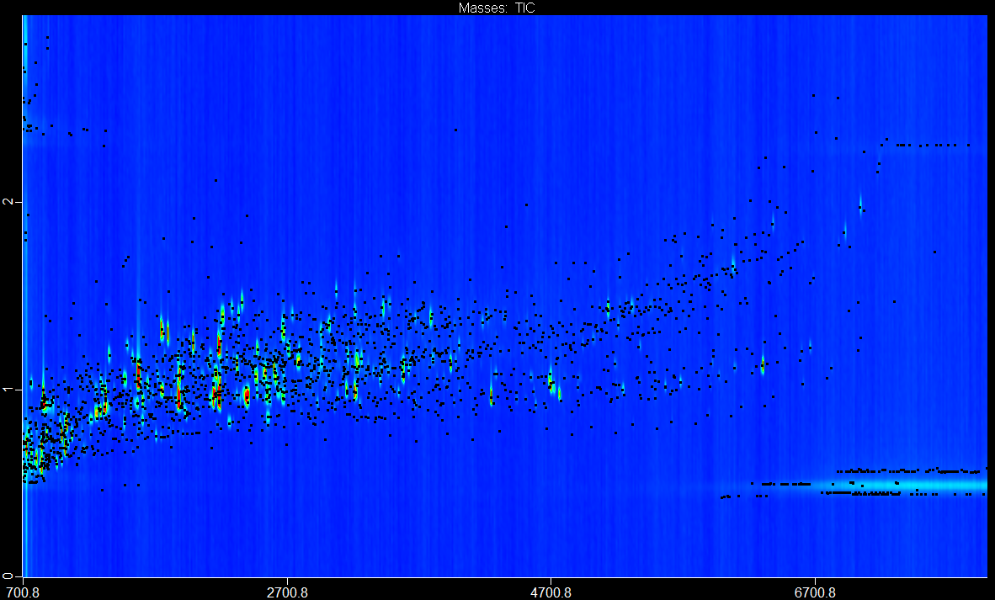
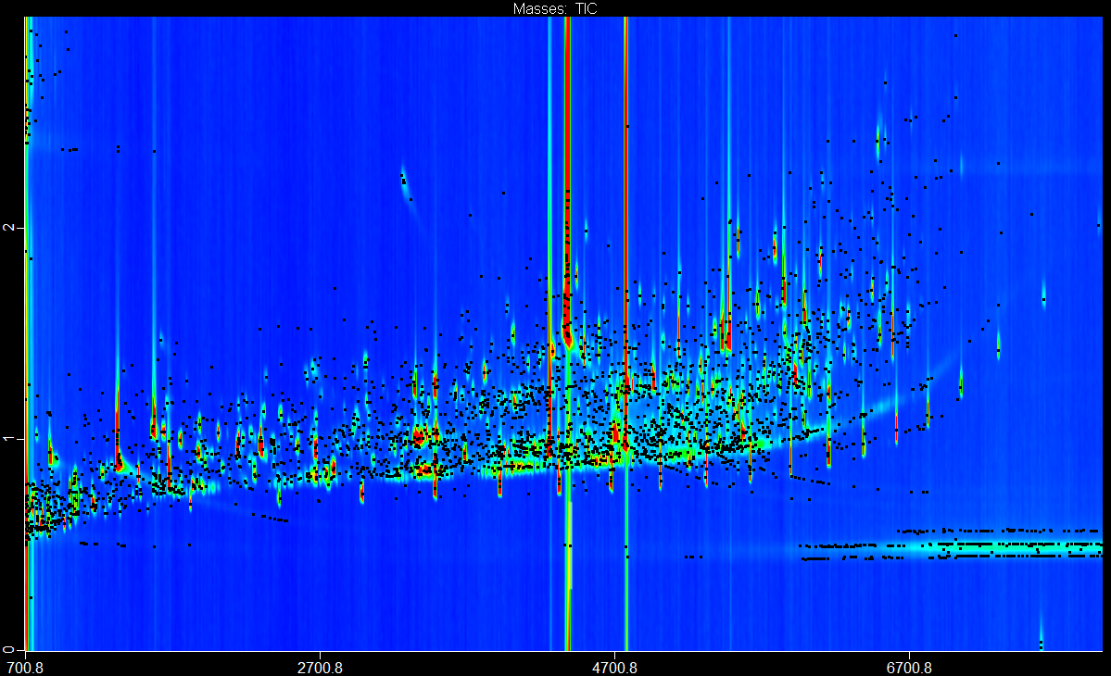
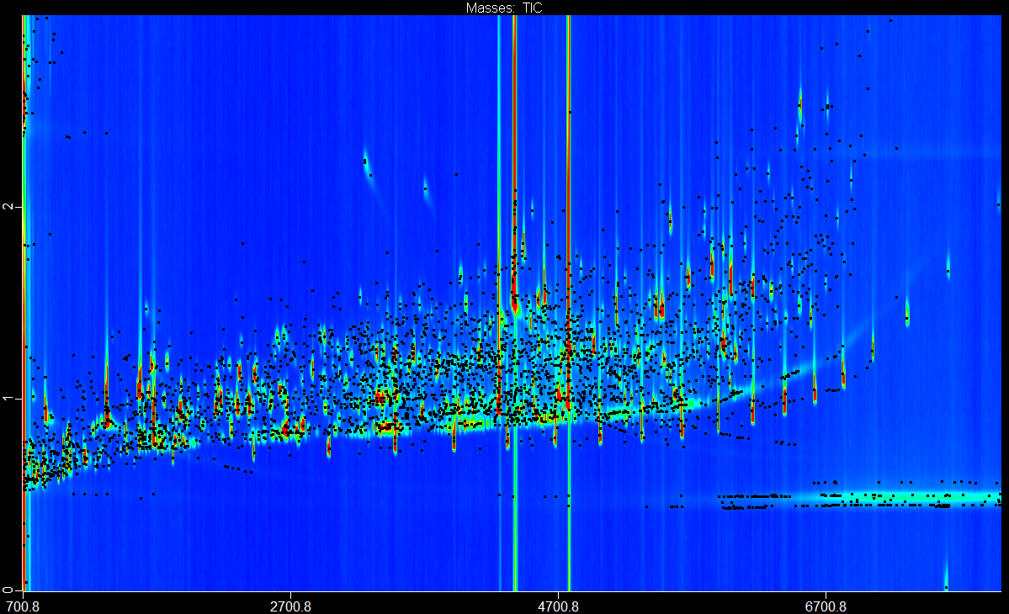
Wood Smoke (Gas-phase + Particle-phase)
The Problem:
How do you identify components after combining two complex mixtures?
~1500 Peaks (S/N>50)
Pre-Smoke Exposure Urine of a Firefighter
~3800 Peaks (S/N>50)
Post-Smoke Exposure Urine of a Firefighter
~4300 Peaks (S/N>50)

Slide 40
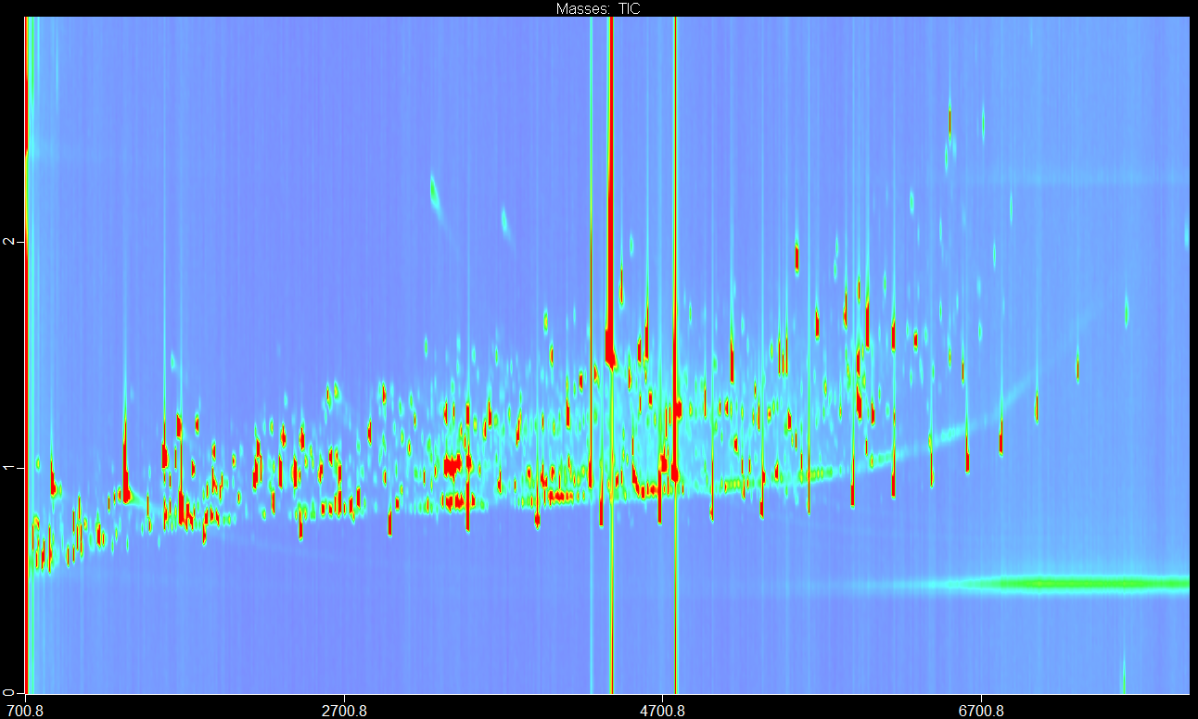
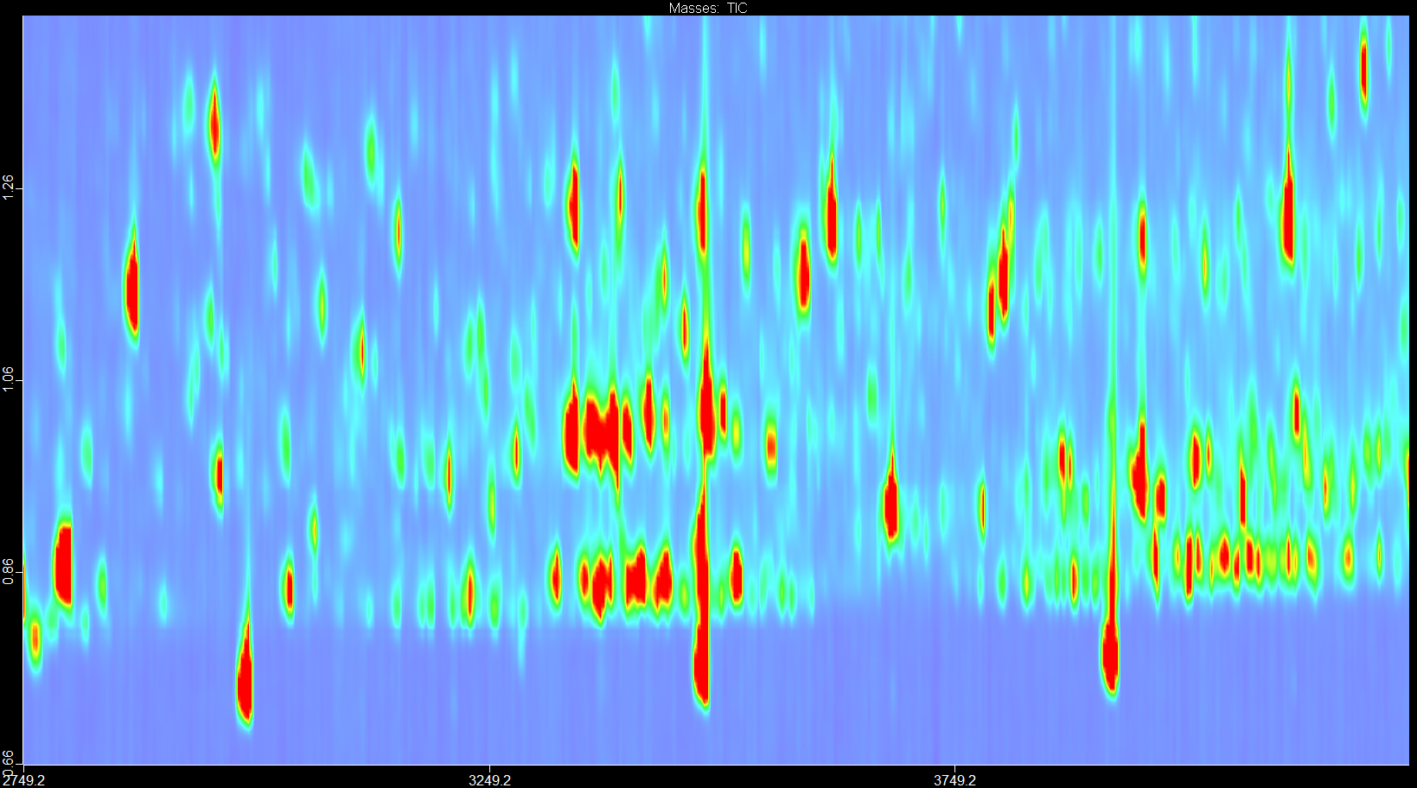
Firefighter Post-smoke Exposure Urine
~4300 Peaks (S/N>50)

Slide 41
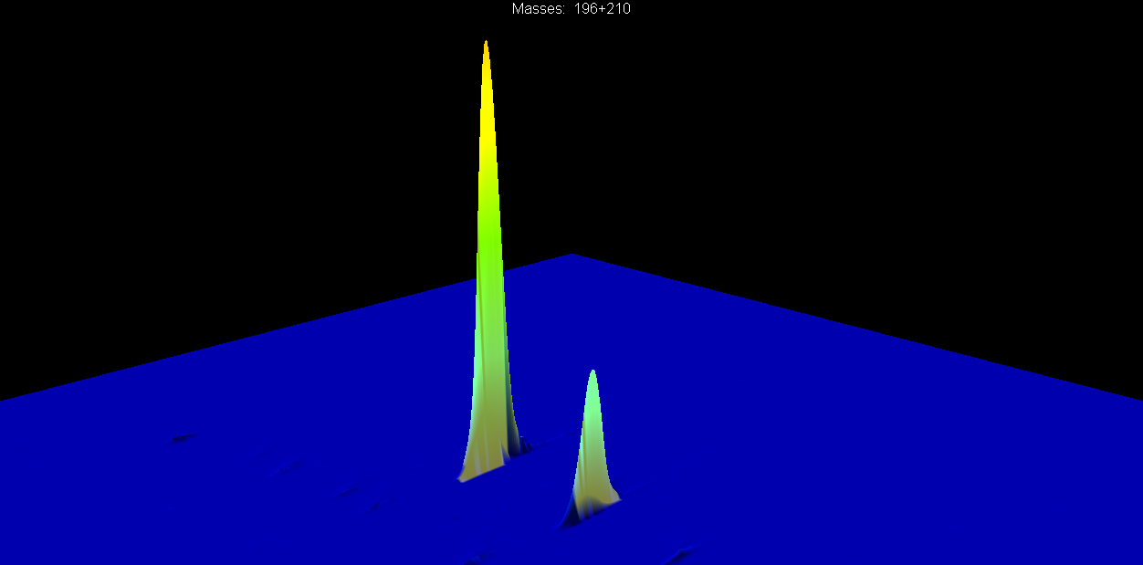
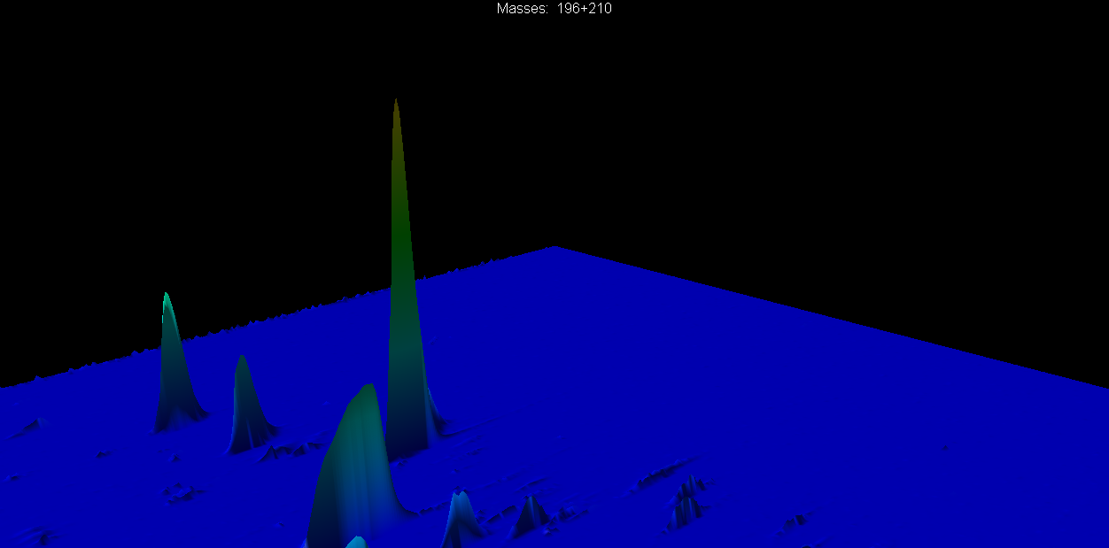
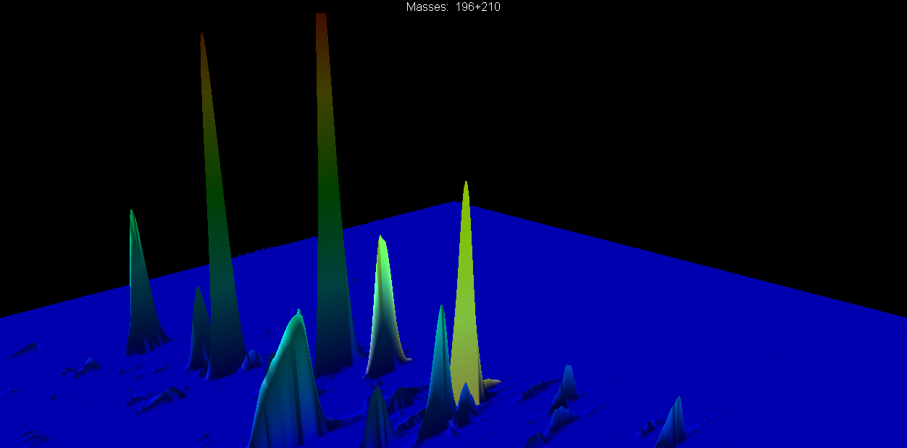
Extract of Wood Smoke
syringol
methylsyringol
Methylsyringol is reported to be
the best urinary marker for
conifer-derived wood smoke.
Pre-exposure Urine
syringol
methylsyringol
Neither syringol nor methylsyringol
are present in urine prior to exposure.
Post-exposure Urine
syringol
methylsyringol
Both syringol and methylsyringol
present in post-exposure urine.

Slide 42
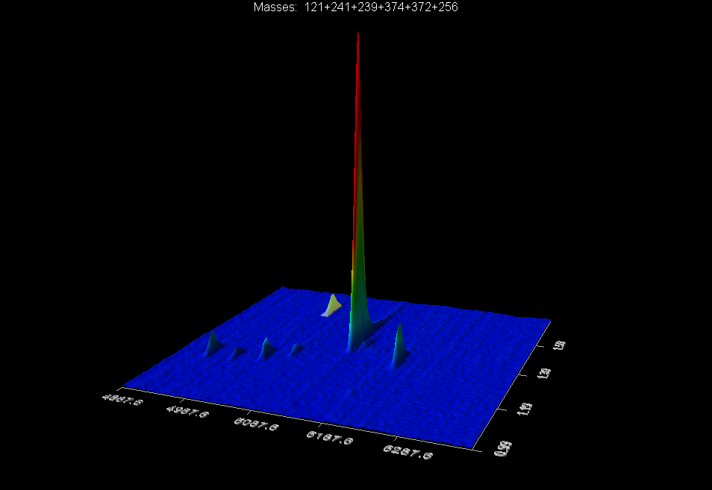
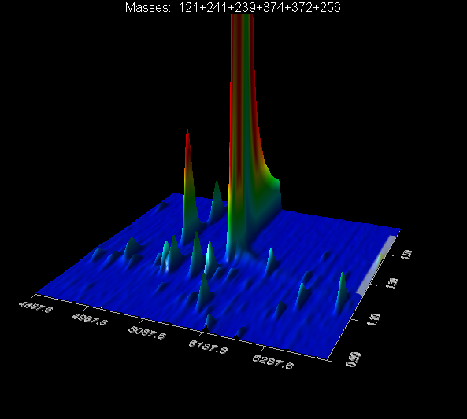
Resin Acids in Wood Smoke
Oxodehydroabietic acid-TMS
Dehydroabietic acid-TMS
Sandaracopimaric acid-TMS
Isopimaric acid-TMS
Abietic acid-TMS
Pimaric acid-TMS
Resin Acids in Post-exposure Urine
Oxodehydroabietic acid-TMS
Dehydroabietic acid-TMS
Sandaracopimaric acid-TMS
Isopimaric acid-TMS
Abietic acid-TMS
Pimaric acid-TMS
Pimaric acid-TMS
Isopimaric acid-TMS
Abietic acid-TMS
Dehydroabietic acid-TMS
These compounds are not present in urine prior to smoke exposure.

Slide 43
GC-MS/MS Analyses of Urine Samples
Fold increase in post-exposure urine of selected smoke marker compounds in the urines of exposed firefighter compared to pre-exposure levels.
Isopimaric acid (15,000x)
C₅-Guaiacol-1
(7,500x)
Pimaric acid (600x)
Fire training exercise from 10-10:30 a.m.

Slide 44
Fold Increase in Post-exposure Urine (log scale)
isopimaric acid
acetovallinone
?
?
?
?
2-hydroxynaphthalene
2-hydroxyphenanthrene
?
?
?
eugenol
?
?
syringol
methylsyringol
?
Indicates compounds that are commercially available
?
Indicates compounds that are unknowns
44

Slide 45
Take-home Messages – Part 5
New chemical markers of particulate smoke exposure identified.
No chemical markers of particulate exposure exist.
Additional urinary smoke markers also identified.
Ten chemicals identified in urine which showed more than 1000x increases following smoke exposure.
Recommendations:
  These new markers should be investigated in detail so see how useful they are as measures of smoke and particulate exposures.

Slide 46
Conclusions: Fire Fighter Smoke Exposures
Fire fighters in fire-training exercises experience wide range of exposures to over 1500 fire-generated chemicals.
Skin analyses of fire fighter trainees showed they received similar exposures to smoke chemicals at five body sites. Fire fighters likely receive a “whole-body exposure” to smoke.
Methylsyringol and three hydroxyfluorenes are excellent urinary markers of smoke exposure.
Ten new wood smoke chemicals identified in urine which show huge changes (>1000-fold) pre-exposure versus post-exposure.
Smoke chemicals are substantially cleared from the body within 24 hours.

Slide 47
Recommendations to Reduce Smoke Exposures
Fire fighters should shower at the fire station.
Fire fighters should wear clean clothes home after a fire.
Fire fighters should make sure that their SCBA mask fits properly on their face.
The reasons for the variability of smoke markers in urine needs to be sorted out.

Slide 48
The Future
WSIB grant has ended.
We are in the process of arranging meetings with the 28 fire fighters who participated in this study.
Interviews will be conducted by Lorraine Shaw (CIH), Don Shaw (CIH) and Dr. Ron House, an occupational health physician.
We have applied for provincial funding to follow up on this study.

Slide 49

Acknowledgements
We would like to thank:
  The Ontario WSIB for funding this study.
  Fire Services in Burlington, Hamilton, Ottawa and Toronto for all their cooperation and assistance.
  The Ontario Professional Fire Fighters Association for their kind invitation to speak at this conference.

Slide 51
Airborne Particulate Concentrations
>98% of smoke particulate is less than 1 micron in diameter
OEL 10 mg/m³

Slide 52


California Wildfires:
October 24, 2007
Many wildfire fire fighters are
exposed to high levels of smoke
when fighting these fires. There
are serious concerns about smoke
exposures of these fire fighters.

Slide 53
Conclusions
GC×GC-TOF-MS and GC-MS-MS Analyses of Wood Smoke and Urine Samples
GC×GC analyses of smoky air and urine samples of exposed firefighters resulted in the identification of a number of new wood smoke markers.
New urinary markers for smoke particulate exposure identified.
Identification of >200 wood smoke markers in the smoky air and in urine samples using a user-built library and the NIST 2008 library.
GC-MS-MS analyses have been developed for quantitative analysis of wood smoke markers in air, on skin and in urine.

